Slide 1

Bangladesh University of Engineering and Technology
BME 300 : Biomedical Engineering Design 1
Mir Maheen Labib Mehzabin Morshed Raka Stu ID: 201518021 Stu ID:201518022

Slide 2
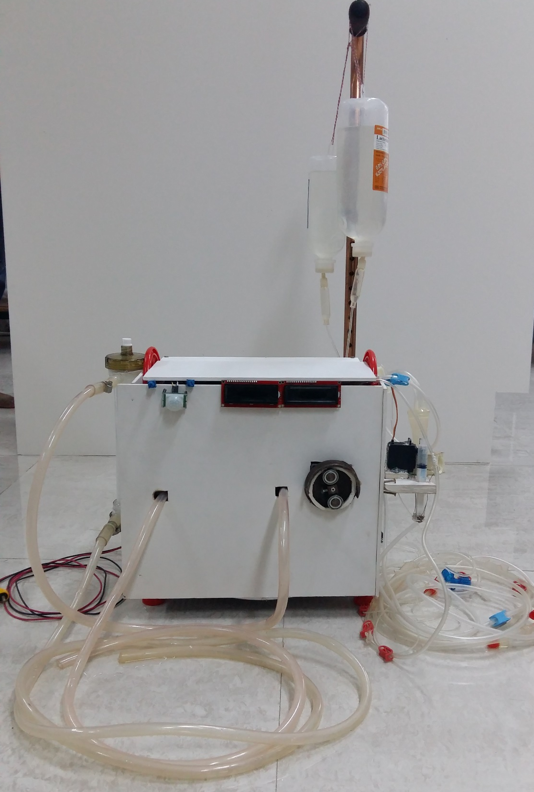
Prototype of a Portable Hemodialysis Machine

Slide 3
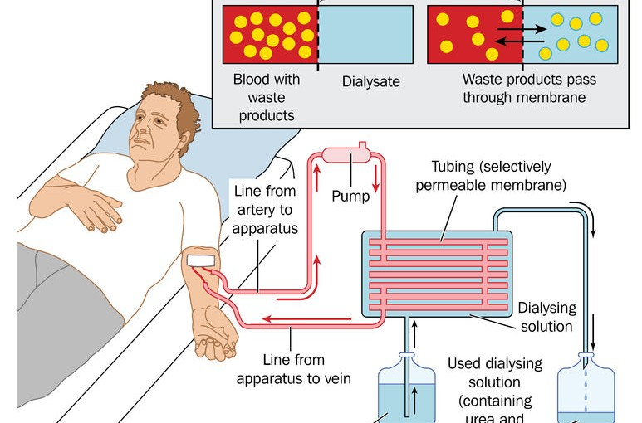
Hemodialysis
Hemodialysis is a method for removing waste products such as urea, potassium as well as free water from blood when the kidneys are incapable of this . People who are suffering from renal failure need hemodialysis.

Slide 4
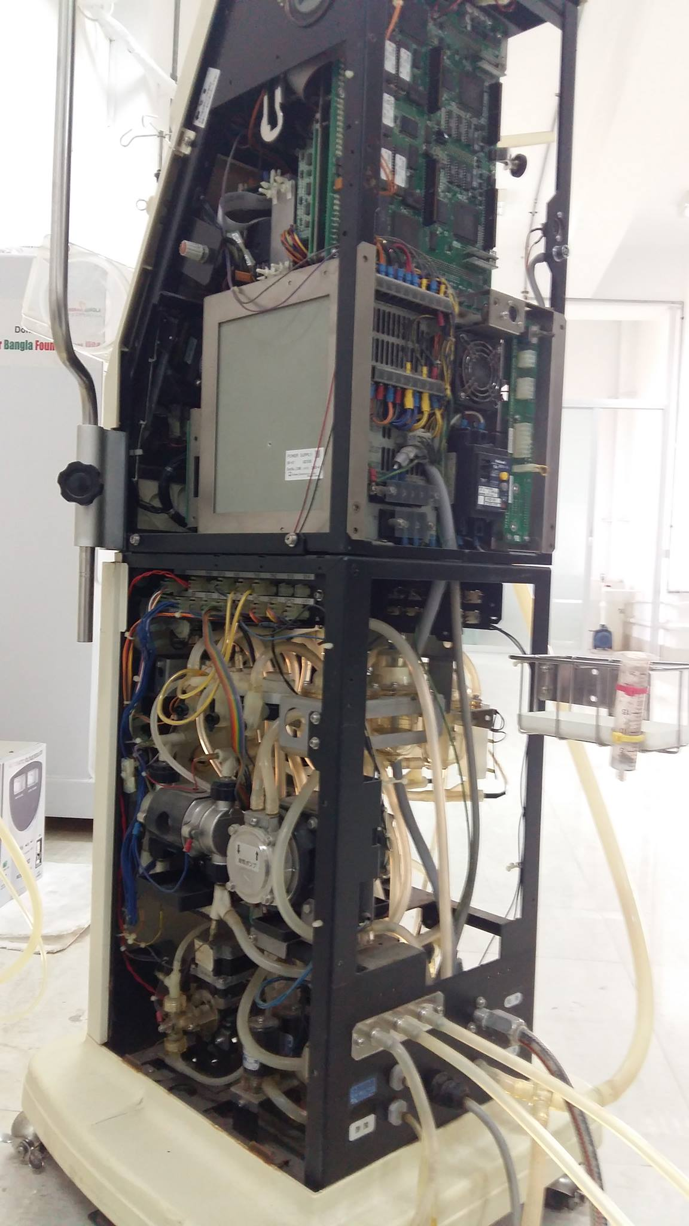
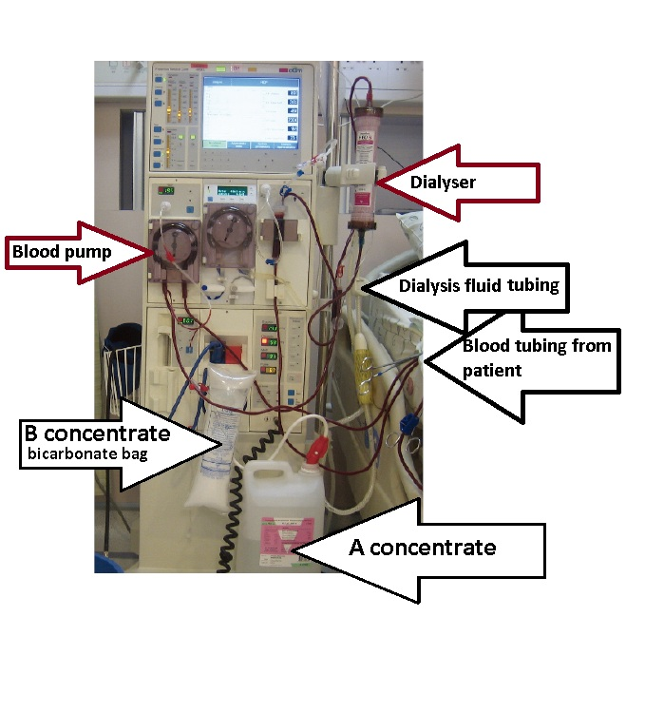
Hemodialysis Machine

Slide 5
Problems leading to our prototype:
The size of the machine
Immobility of the machine
Fixed water treatment plant
Can be used only in the dialysis unit of the hospital
Power supply
Too costly

Slide 6
Border impact of our device:
mobility
Usefulness in any unit of the hospital
Battery Power supply
Cost effectiveness

Slide 7
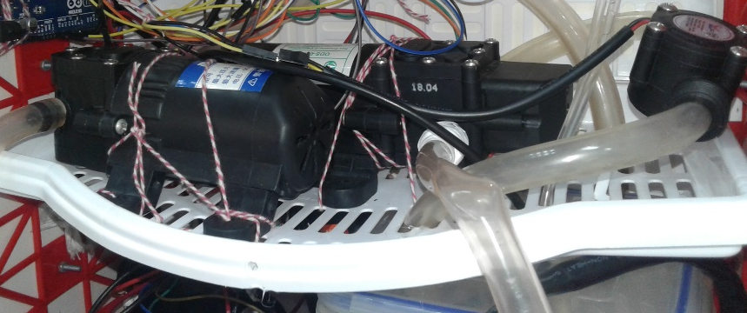

Factors to final design:
Conform to target excretion rates
Maintains blood pressure
Waste is excreted from the system in a sanitary manner
Stable saline stand
Proper alarm system
Feedback flow control

Slide 8
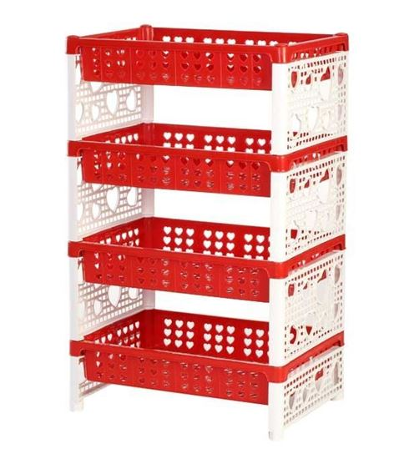

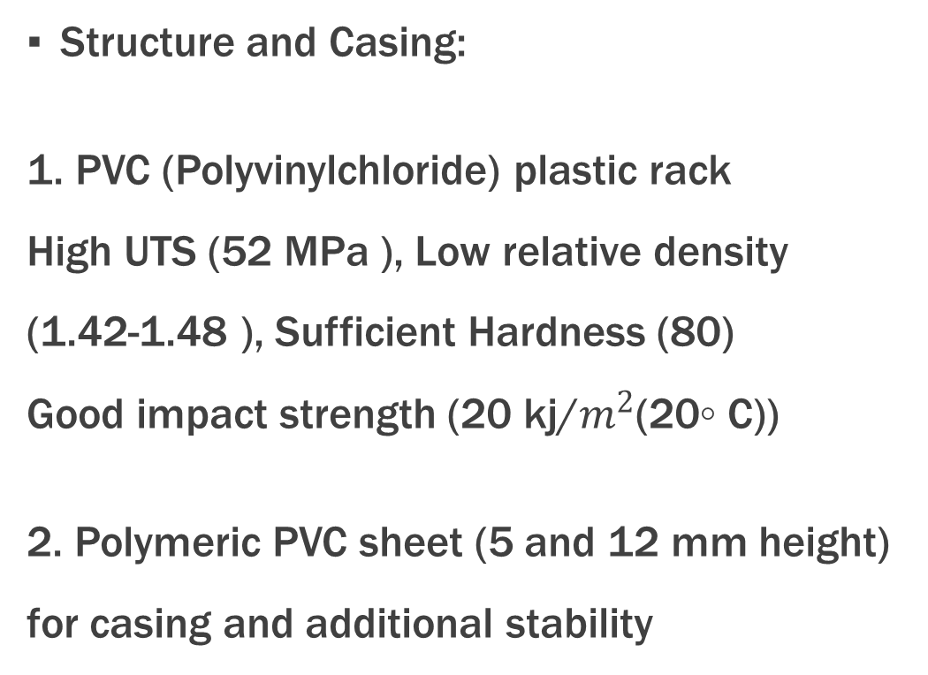
Fabrication process: Materials
Structure and Casing:
1. PVC (Polyvinylchloride) plastic rack
High UTS (52 MPa ), Low relative density
(1.42-1.48 ), Sufficient Hardness (80)
Good impact strength (20 kj/$m^{2}$(20◦ C))
2. Polymeric PVC sheet (5 and 12 mm height)
for casing and additional stability

Slide 9
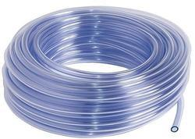
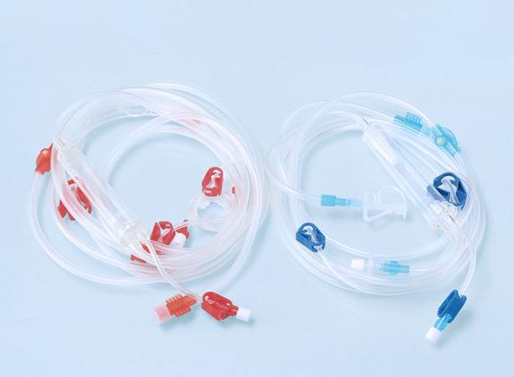
Fabrication process: Materials
Fluid Flow line:
0.8 mm (1/4 inch) diameter clear PVC plastic pipe for DI water and Dialysate solution flow,clear visibility and flexibility (50-80% Elongation at brake)
Rubber connector high elasticity (up to 700% elongation)
Blood Flow Line:
Highly biocompatible one time use rubber pipe hemodialysis blood line sets manufactured specially for dialysis purpose

Slide 10
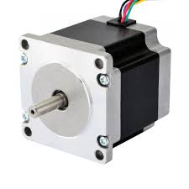
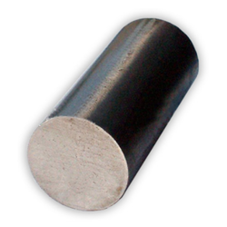
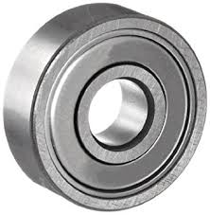

Fabrication process: Materials
Peristaltic Pump:
12V NEMA 23 stepper motor
80 mm diameter Mild Steel Bar pump head, casing and rotter high yield strength (370 MPa) modulus of elasticity (205 GPa)
8/22/7 Deep Groove Ball Bearing low friction

Slide 11
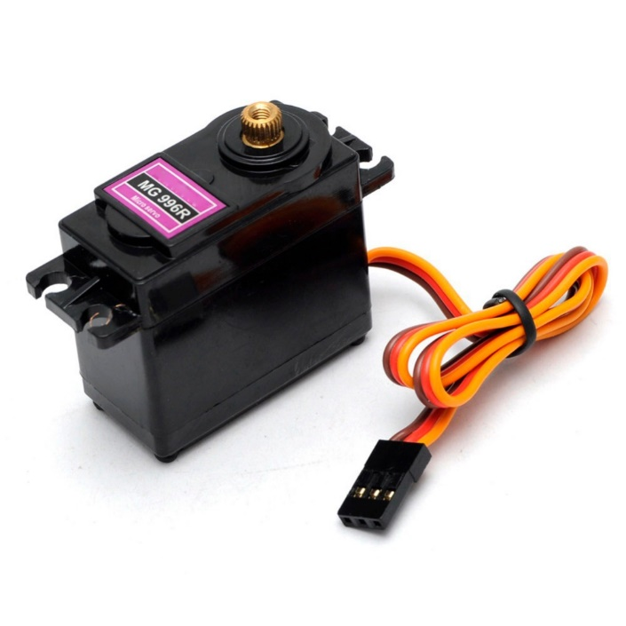
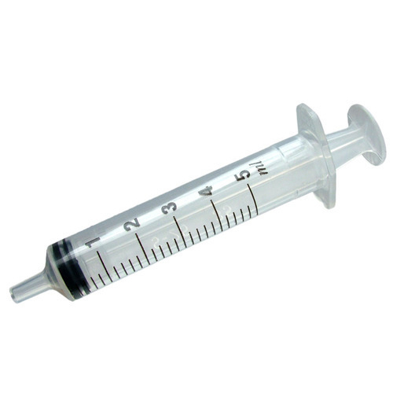
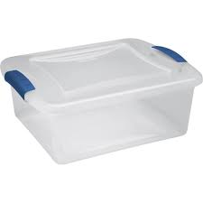
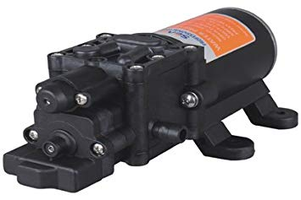
Fabrication process: Materials:
Syringe Pump:
1. MG996R servo motor:
5 ml syringe
Metal wires normal pulley system
Water Pumps: 12V DC water pumps
Mixing chamber:
PVC plastic container

Slide 12
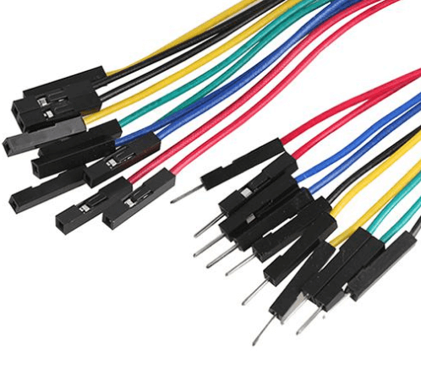
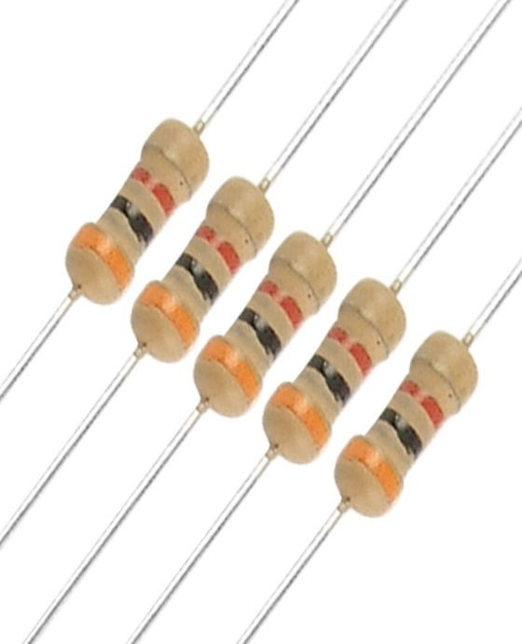
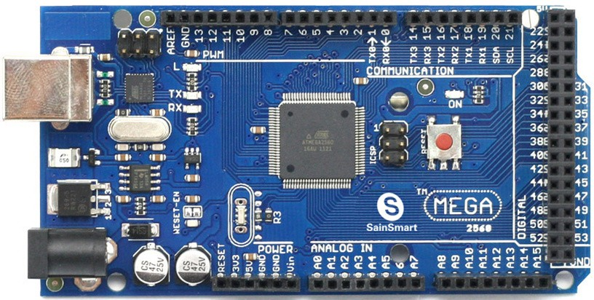
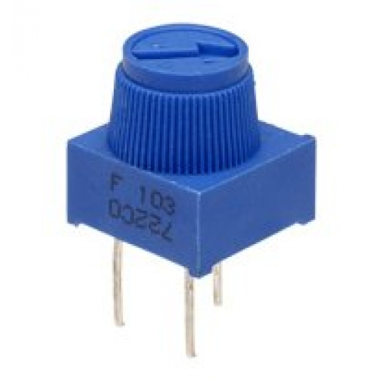
Fabrication process: Materials:

Slide 13
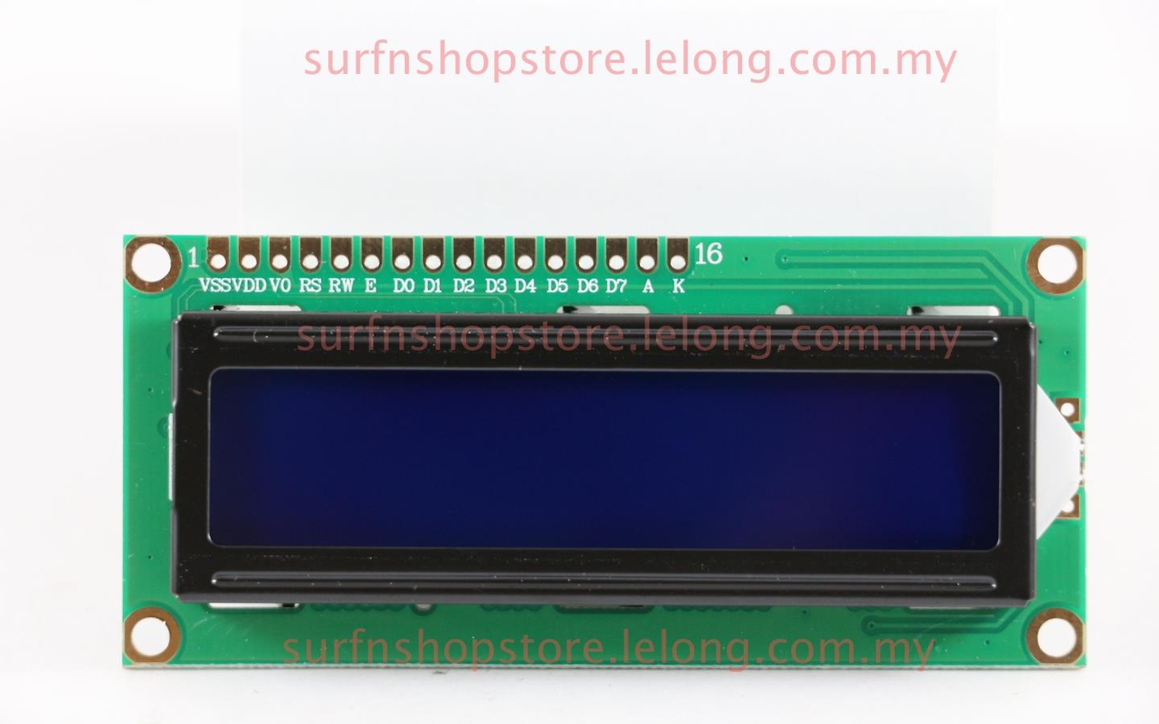
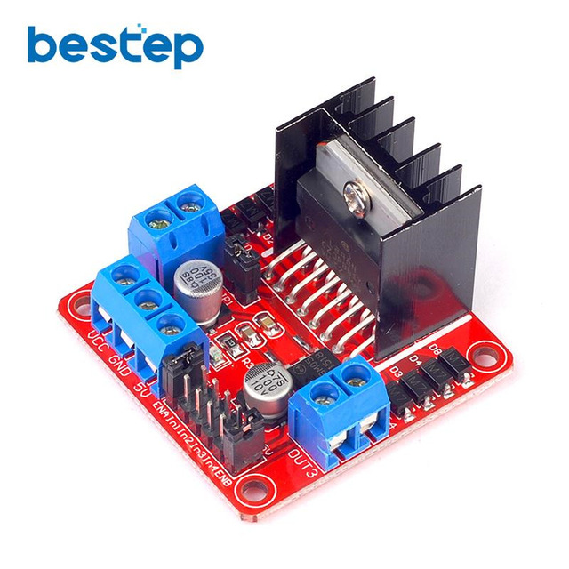
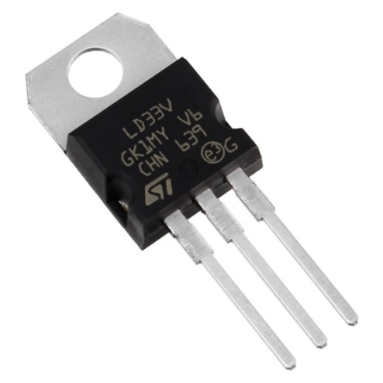
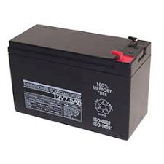
Fabrication process: Materials:

Slide 14
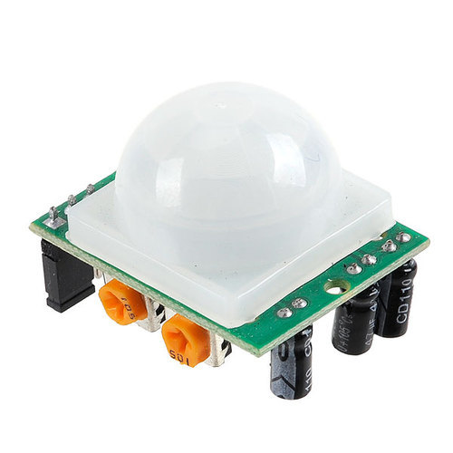
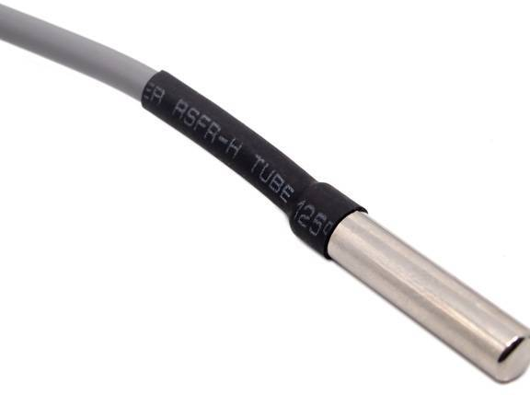
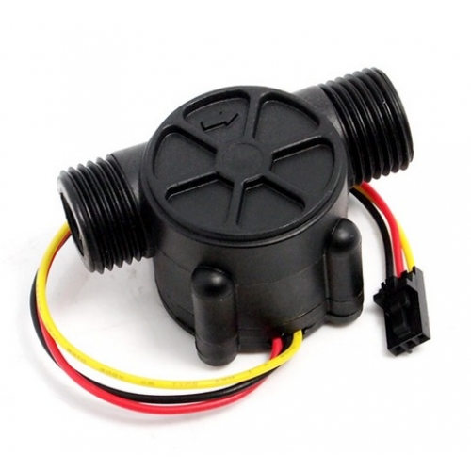
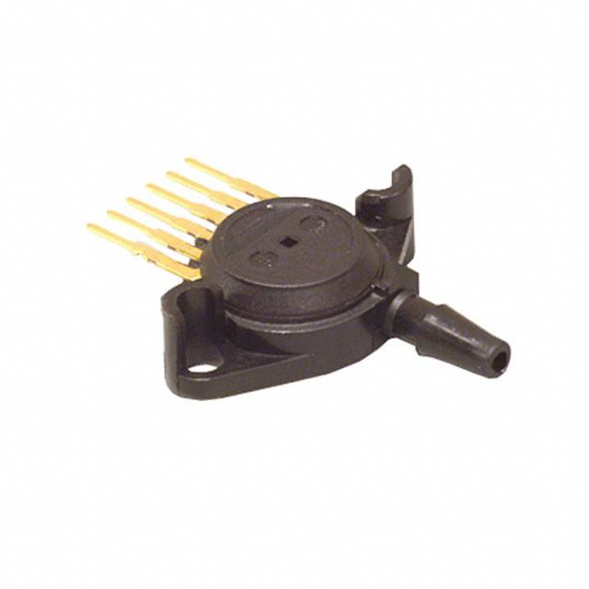
Fabrication process: Materials:

Slide 15
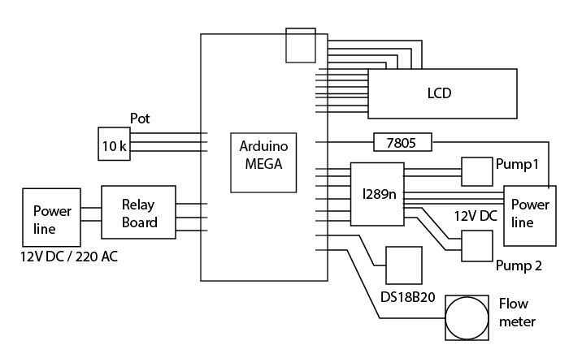
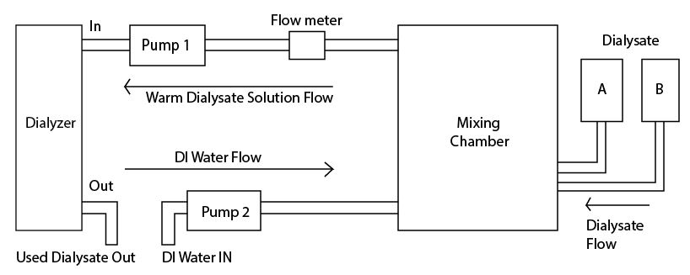
Fabrication process: Methods: dialysate flow line & controller

Slide 16
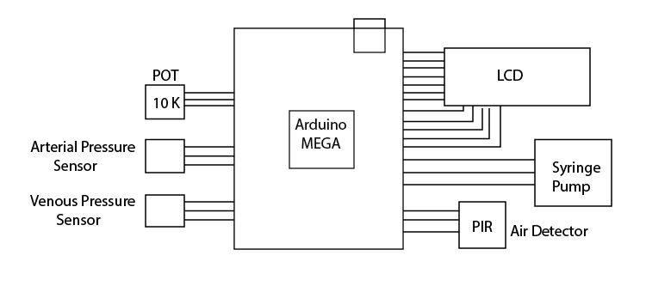
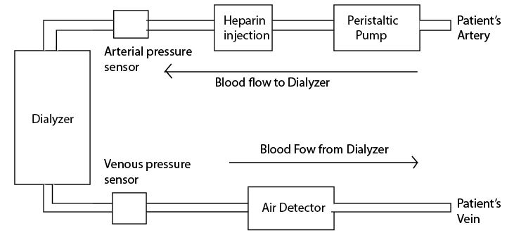
Fabrication process: Methods: blood flow line & controller

Slide 17
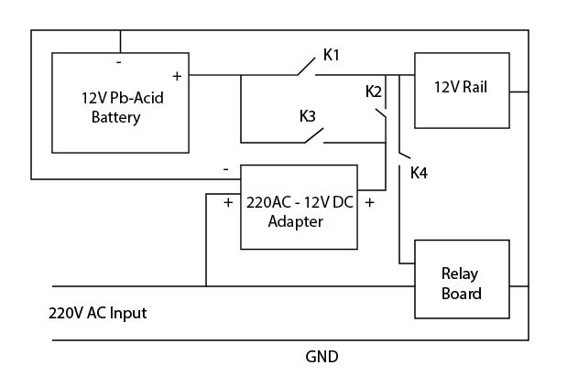
Fabrication process: Methods:
Power connection:

Slide 18
PRODUCT DESIGN SPECIFICATION:
Blood Flow rate= 200 to 220 ml/min
Heparin used= 1 cc
Saline = 1 bag or 450 ml
Ultrafiltration goal= 1000ml/ 4 hours (dialysate A and B)
Ultrafiltration rate= 250 ml/hour (dialysate A and B)
Dialysate solution flow rate = 550 ml/min (usually)
DI water flow rate =500 ml/min (usually)
Temperature monitoring= 37◦C constant
Device should be reduced in size and weight.
The power supply should be mobile for Portable dialysis machine.

Slide 19
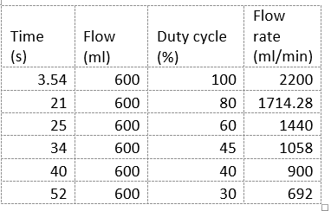
Evaluation: dialysate solution flow rate

Slide 20
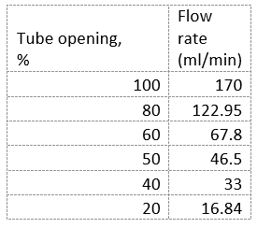
Evaluation: dialysate A & B flow rate

Slide 21
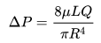
Evaluation:
Dialysate Pressure result:
Hagen-Poiseuille equation
Where:
ΔP is the pressure difference between the two ends,
L is the length of pipe,
μ is the dynamic viscosity,
Q is the volumetric flow rate,
R is the pipe radius.

Slide 22
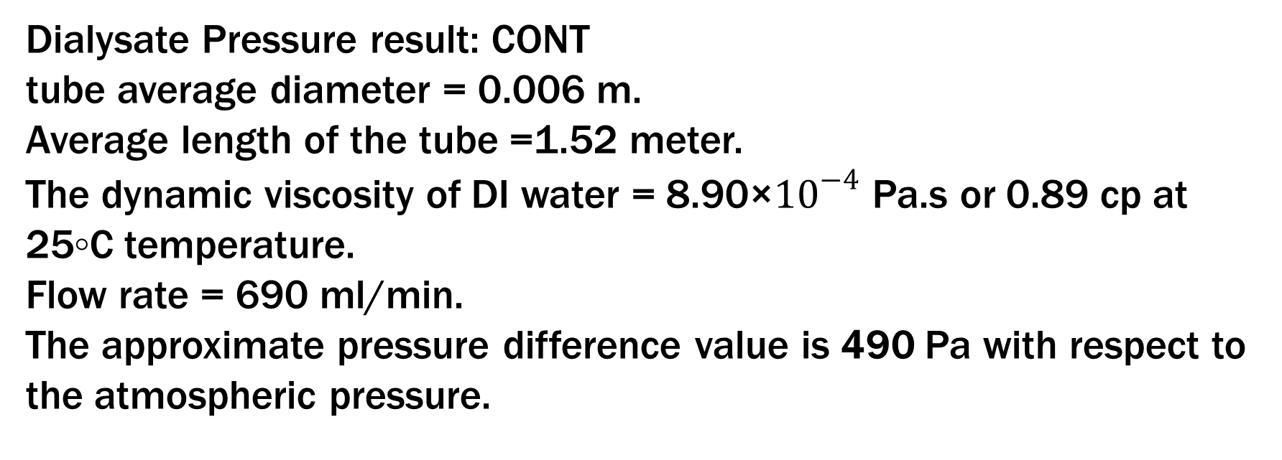
Evaluation:
Dialysate Pressure result: CONT
tube average diameter = 0.006 m.
Average length of the tube =1.52 meter.
The dynamic viscosity of DI water = 8.90×${10}^{−4}$ Pa.s or 0.89 cp at 25◦C temperature.
Flow rate = 690 ml/min.
The approximate pressure difference value is 490 Pa with respect to the atmospheric pressure.

Slide 23
Evaluation:
Peristaltic Pump Testing:
1. 2 shoe for compressing the tube
Height of the bearing =7 mm
which was lower than tube diameter= 10 mm.
The minimal distance between the bearing and casing wall = 4 mm instead of 2.5 mm due to the machine cutting error of metals.
All these reasons made high amount of backflow of fluid and reducing the flow rate to 1 to 2 ml/min only.

Slide 24
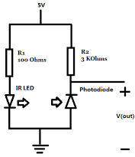
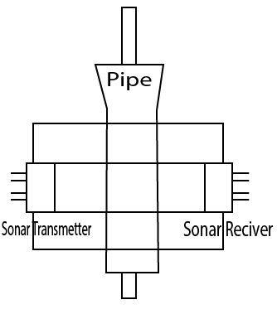
Evaluation:
Air Detector Testing:
Photodiode: An LED and the diode were placed across the blood tube in a dark medium,the differential value between air or fluid presence= 2 to 4 analog value range.
Sonar sensor: 2 to 3 microsecond pulse Insufficient for blood tube penetration.

Slide 25
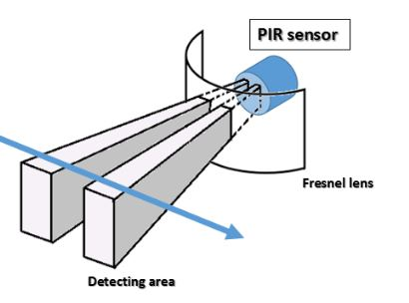
Evaluation:
Air Detector Testing: PIR sensor:
It gave digital output value at a continuous rate when the blood in present. If air was present in the tube it returned no value for long time.

Slide 26
Evaluation:
Heater Testing:
6 watt at 12V supply.
Temperature change =0.72◦C/min.
Temperature maintaining 37◦C.
Power Line Testing:
The voltage output =12.3V (connected to the battery at full charge)
The voltage output =13.8v (connected to the 220V AC line)
A voltage limiting POT used all the 5V supplies were made using 7805 IC

Slide 27
Evaluation:
Heparin Pump Testing:
syringe total capacity = 5 ml
The maximum volume it could deliver =2.5 ml
due to mechanical system loss at a short 30 min period of time.
Sensor Testing:
Flow Sensor Calibration: the calibration factor was set to 4.5
Pressure Sensor Testing: 0.5 m water level testing the calibration factor was set to 4.5

Slide 28
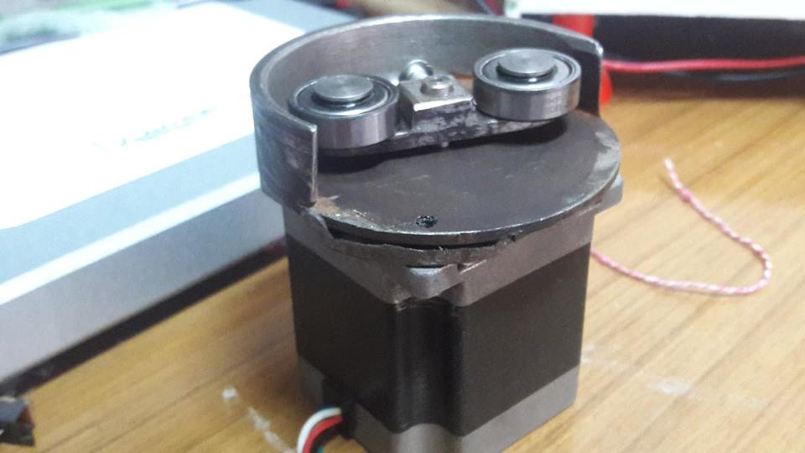
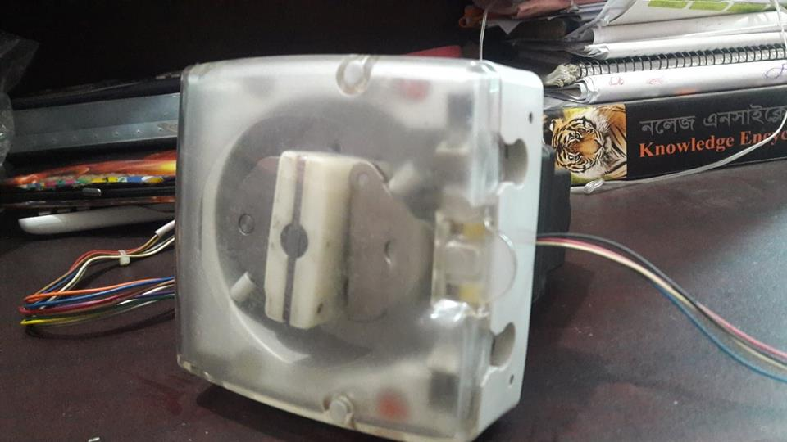
Specific info. Of final prototype:
Peristaltic Pump:
Designed Pump Clinically used pump
Casing
Rotor
Bearing
Motor

Slide 29

Specific info. Of final prototype
Dialysate flow line:
Pump
Pipes
Flow meter
Controller
circuit

Slide 30
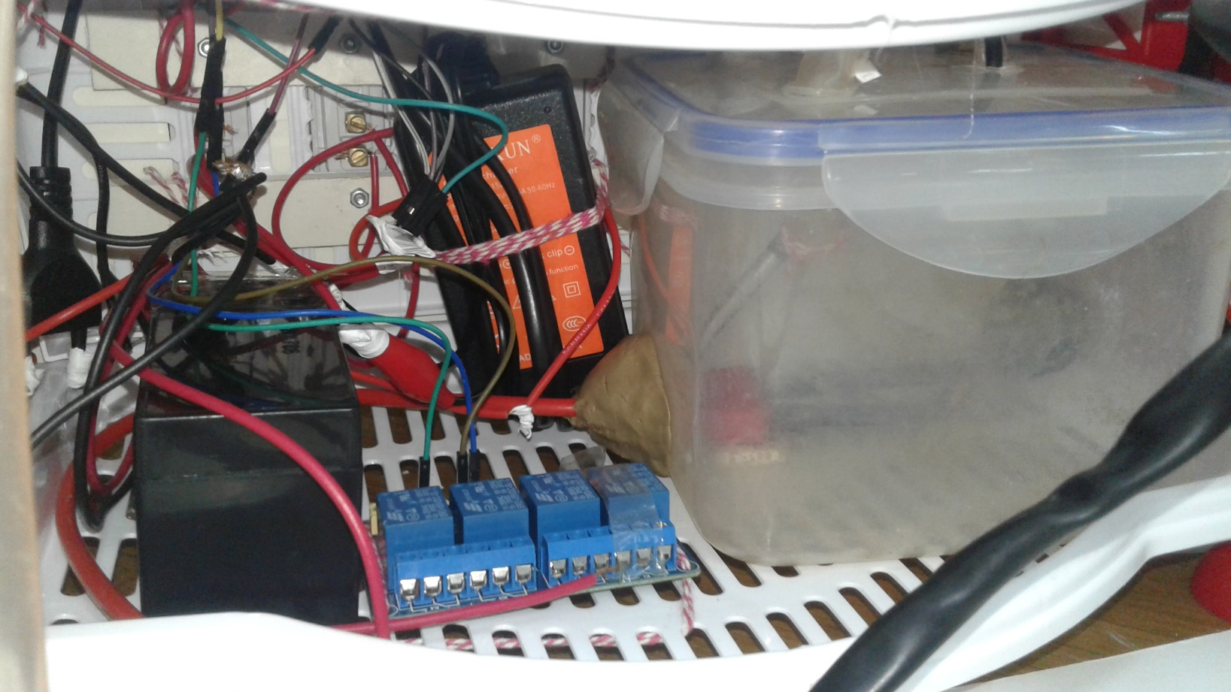
Specific info. Of final prototype
Power line and mixing chamber:
Mixing chamber
Battery
Relay board
Adapter
Switches

Slide 31
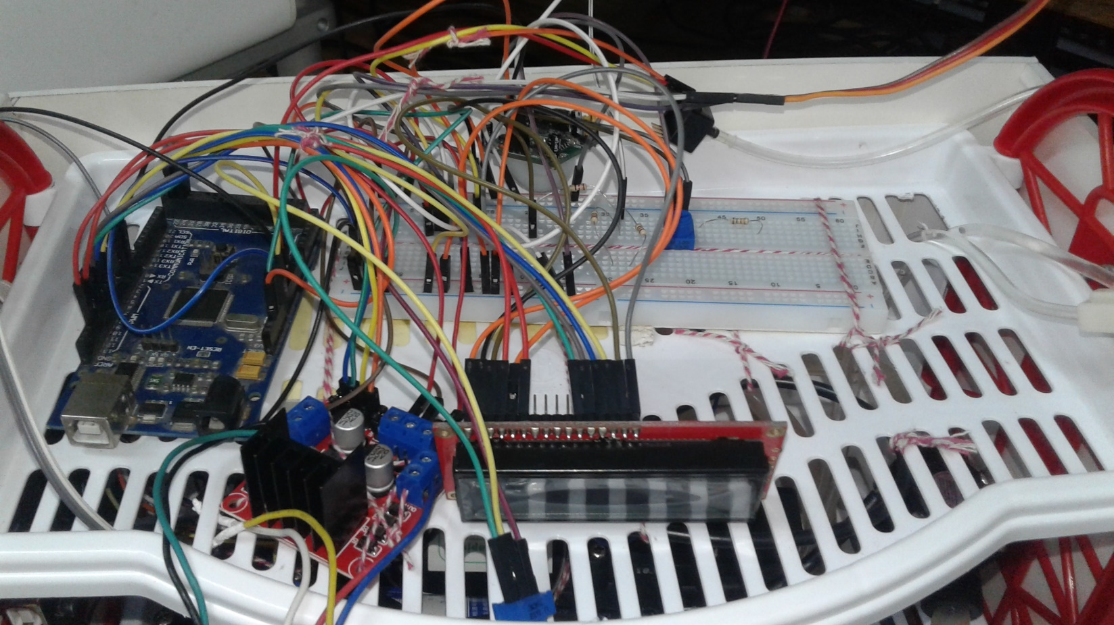
Specific info. Of final prototype
AV line controller circuits and sensors:
AV line controller
LCD
L298n motor driver
POT
Pressure sensor

Slide 32
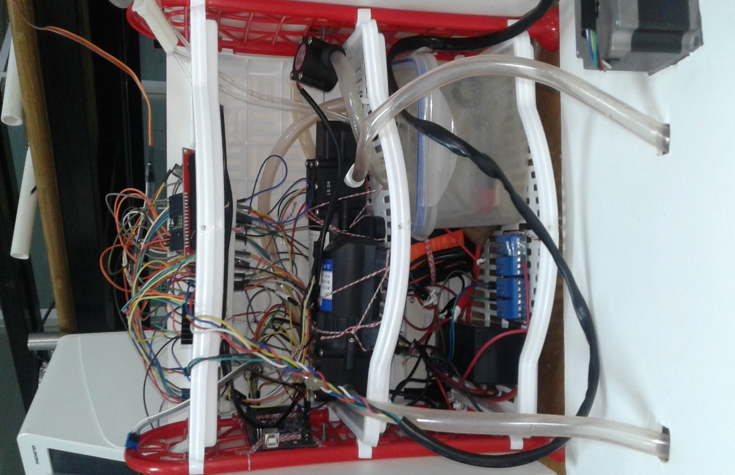

Specific info. Of final prototype
Interior: Exterior:

Slide 33
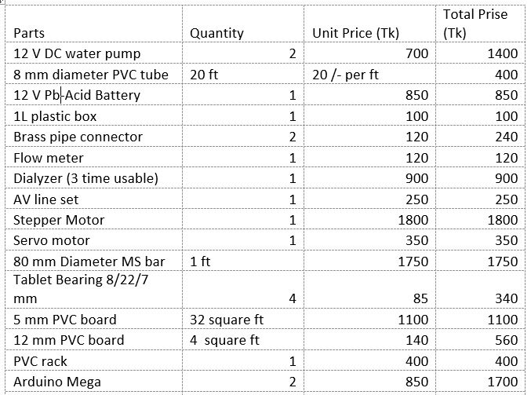
Budget
Total Cost:
Continued…

Slide 34
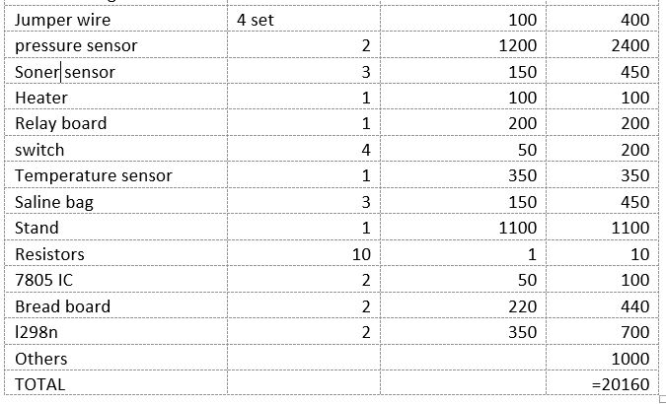
Budget

Slide 35
Have we found the solution?
Size reduced
Mobility increased
Can be used in other units of a hospital as well as at home
Cost will eventually reduce
Power & water treatment problem will hopefully be addressed later on

Slide 36
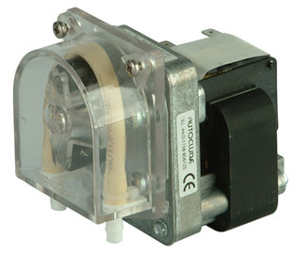
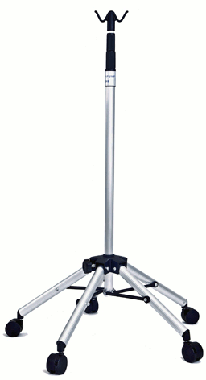
Limitations:
Manual dialysate flow control
Faulty bubble detector
Small range syringe pump
Absence of cooler
Peristaltic pump
Absence of folding saline stand

Slide 37
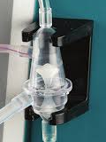

Future goals:
Control dialysate flow by pumps
Construct perfect bubble detecting system
Making full range syringe pump
Developing cooling system
Peristaltic pump set up
Making folding saline stand

Slide 38


Slide 39
Thank you!

